Slide 1

Savitribai Phule Pune University
K. K. Wagh Institute of Engineering Education and Research, Nashik
Department of Computer Engineering
A
Presentation on Web Development Laboratory
Mini Project
Online Service Maintainance Management System
Group ID - 1
Group Members -
SR.NO | ROLL NO. | EXAM SEAT NO. | NAME OF STUDENT
01. | 35(A) |  | NIKITA KUKREJA
02. | 30(A) |  | NIKITA KALANGE

Slide 2
PROBLEM STATEMENT First, selecting the good Technician for the defective product is usually take a time and makes the customer waiting. Therefore, the time is waste for the customer to be waiting . Secondly, the Product/Part records, Issue Customer bill etc. are not available in normal Online Service Management System. So the customer’s wants to assign a good Technician for their defective product on their request.
DOMAIN KEYWORDS
CSS, Javascript, PHP, XAMPP Server, Bootstrap, Service management.

Slide 3
CONTENTS
Introduction
Objective
Outcomes
Software and hardware requirements
Output snapshots
Conclusion
References

Slide 4
INTRODUCTION
Online Service Management System is India’s leading chain of multibranded Electronics and Electrical services.
The aim of the project is “To provide Electronic Appliances care services to keep the device fit and healthy and customer happy and smiling”.
The Web Application is created for Service Center functions through the “Online Service management System” where Admin or Manager can lessen their errors and efforts in every customer support processing and transactions and making reports.
It is Web Application which is developed in HTML, CSS, PHP and MYSQL. The purpose of this Web Application is to manage the activities of service center. Even a person can handle very easily.

Slide 5
OBJECTIVES
Efficiency : This involves accuracy, timeliness and comprehensiveness of the output.
Portability : The web application should be portable to all environments.
Security : This could be provided by login facility enabling username and password for the user and the administrator.

Slide 6
OUTCOMES
Provision of innovative online access to customers to provide the service about defective products.
Improves the service quality and efficiency.
Service Request data is easily accessible to admin.
It saves the time of user and provides them with up to date information about assign technician.

Slide 7
SOFTWARE REQUIREMENTS
Operating System : Windows 10
Front-end : HTML, CSS, Javascript
Back-end : PHP
Database : MySQL
Web Server : Apache ( XAMPP Server )
HARDWARE COMPONENTS
Processor : i3
Hard Disk : 4 GB
Memory : 1.5 GB RAM

Slide 8
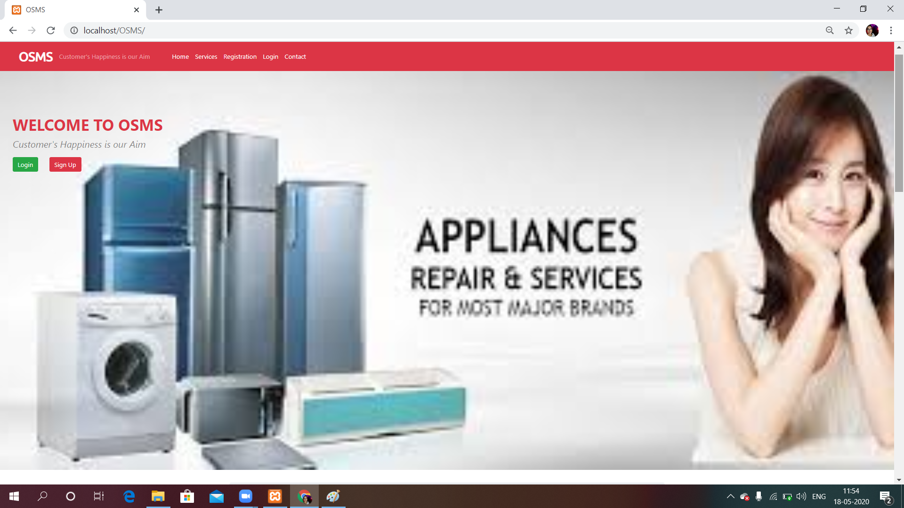
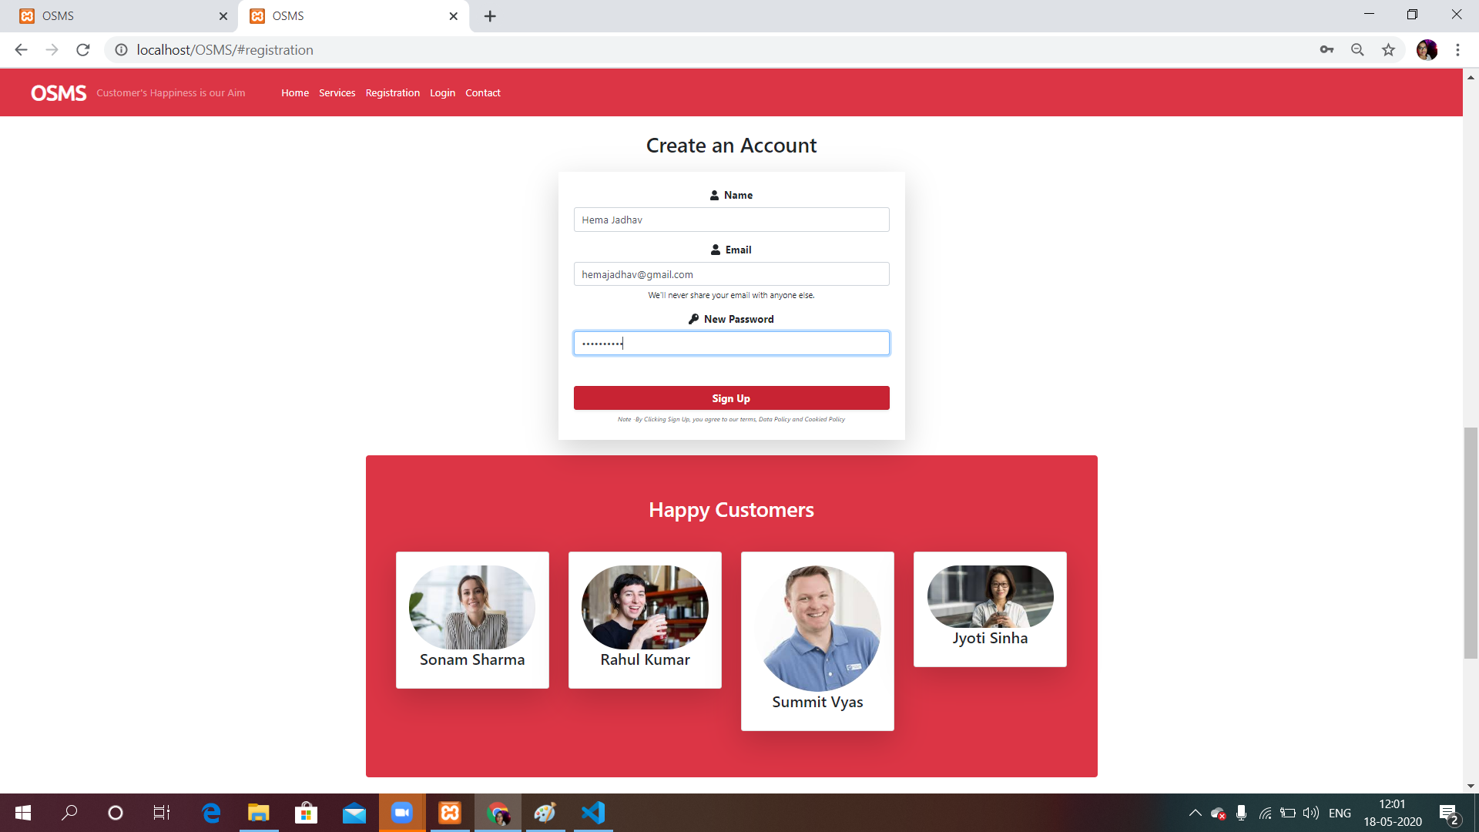
OUTPUT SNAPSHOTS
Front Page
User Registration Page

Slide 9
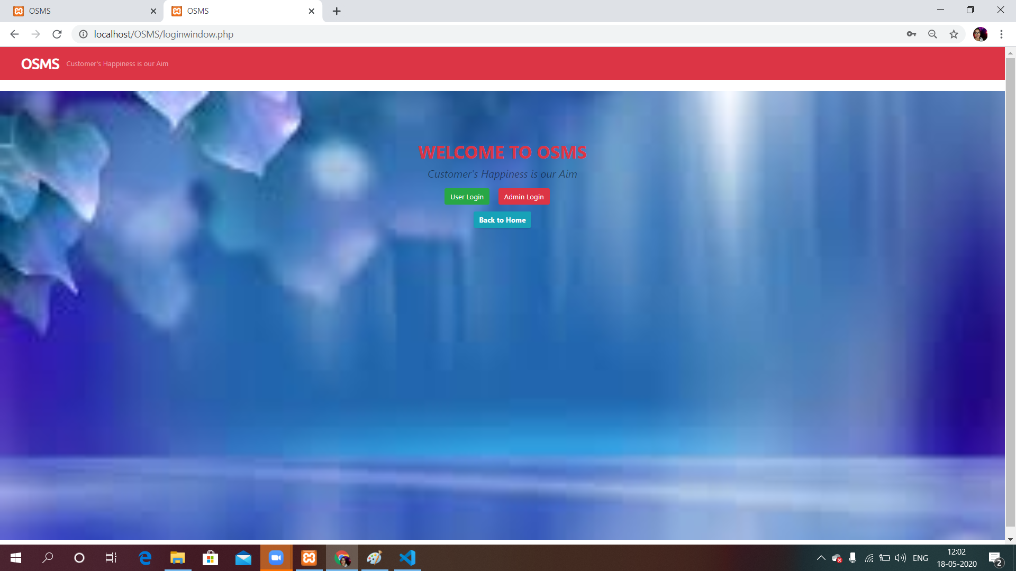
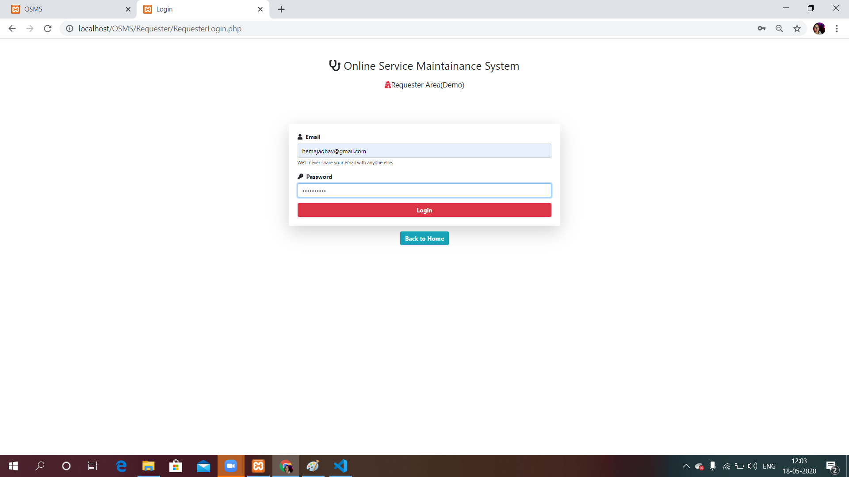
OUTPUT SNAPSHOTS ( Cont. )
Login Window
User Login Window

Slide 10
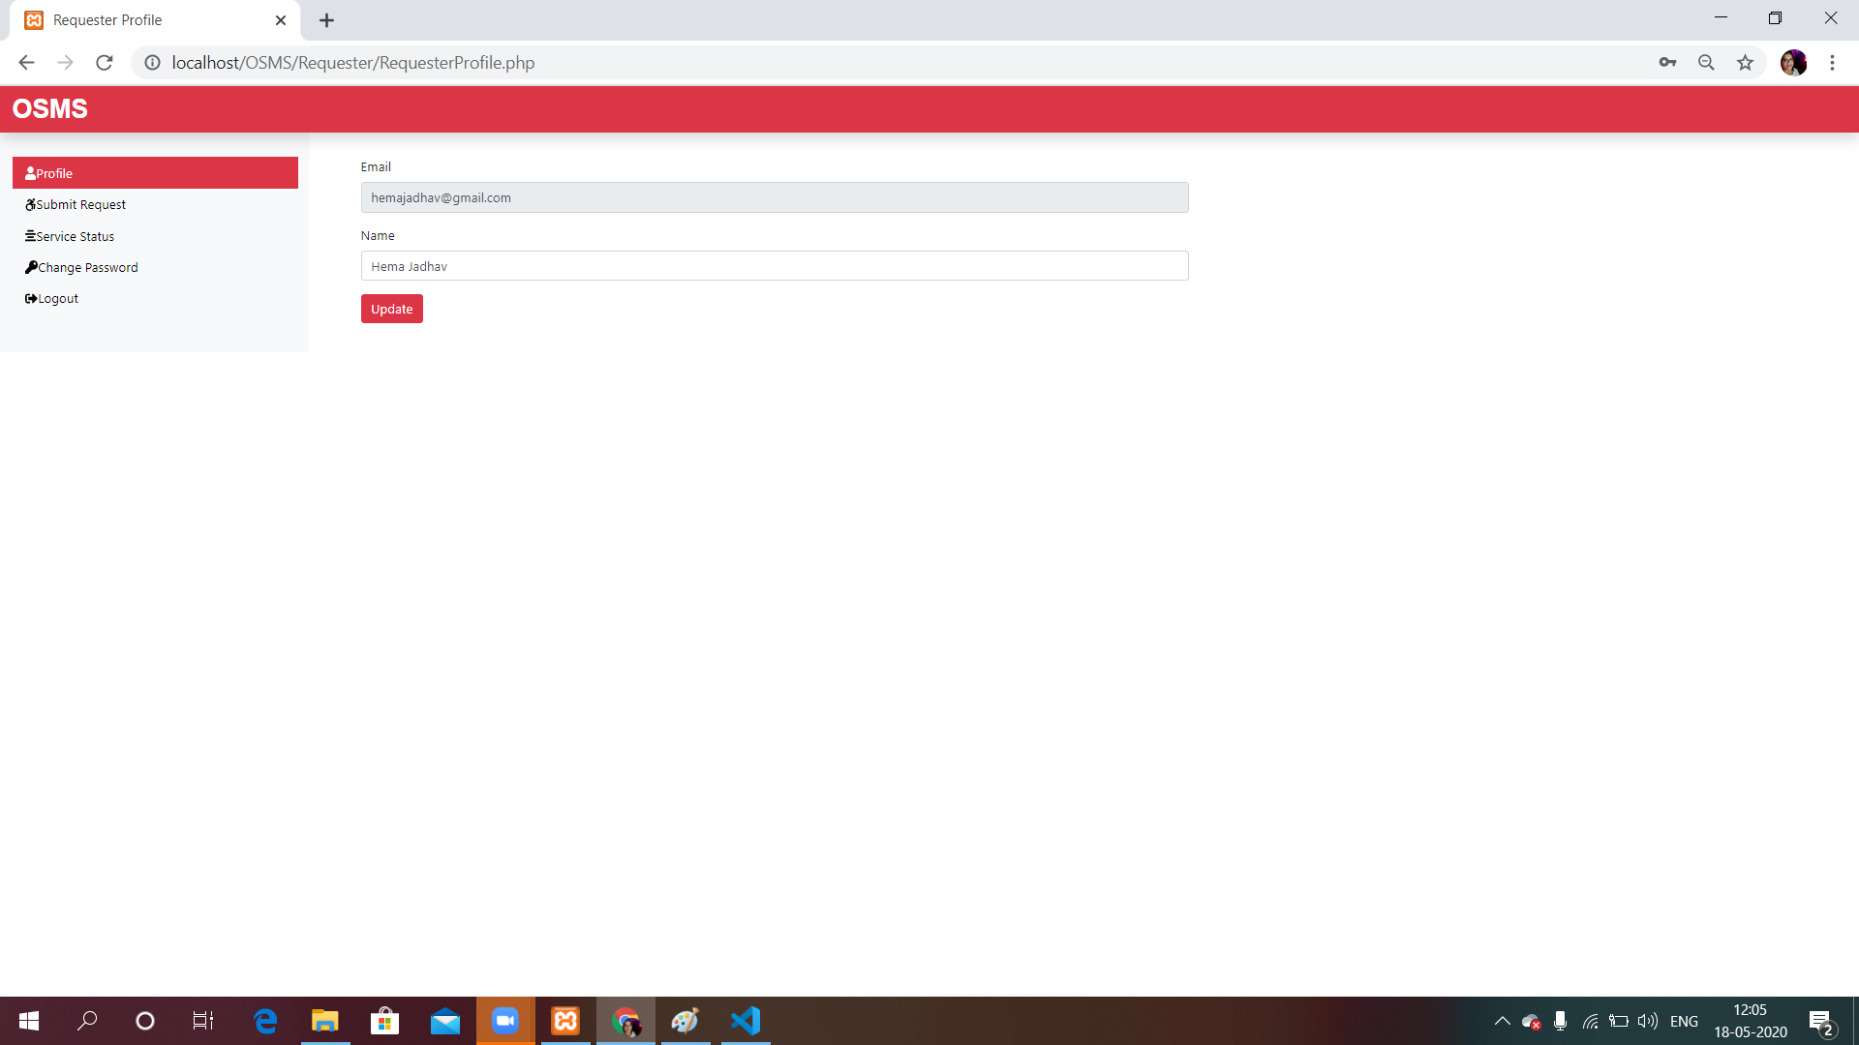
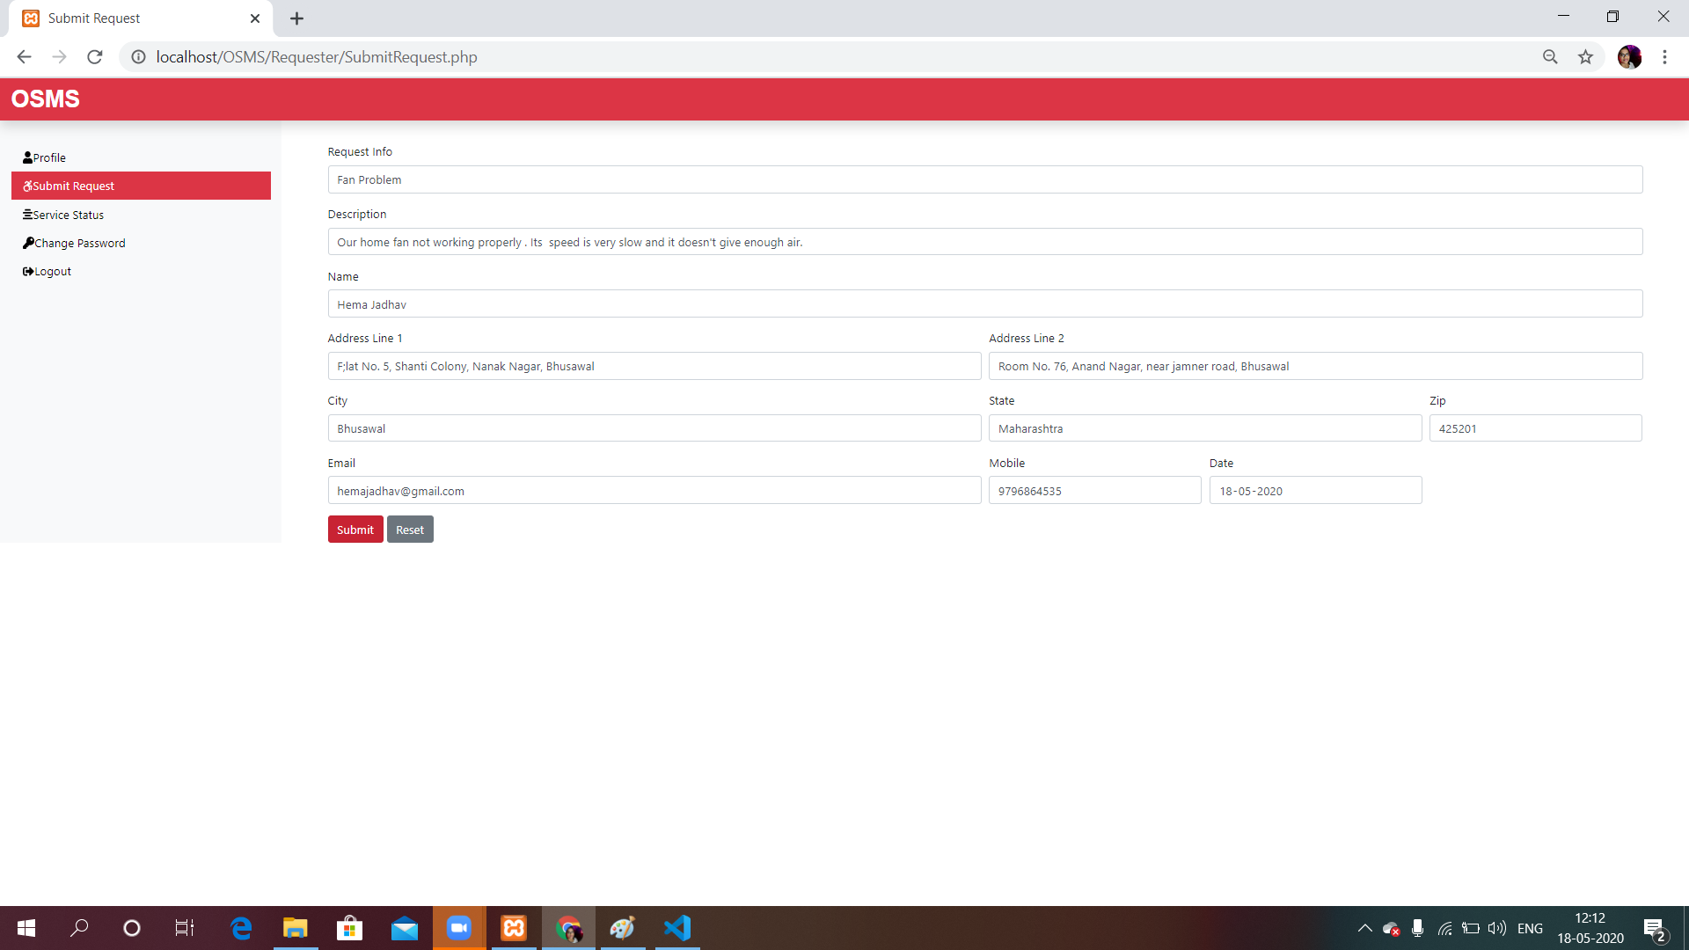
OUTPUT SNAPSHOTS ( Cont. )
User’s Dashboard
User Submit Request

Slide 11
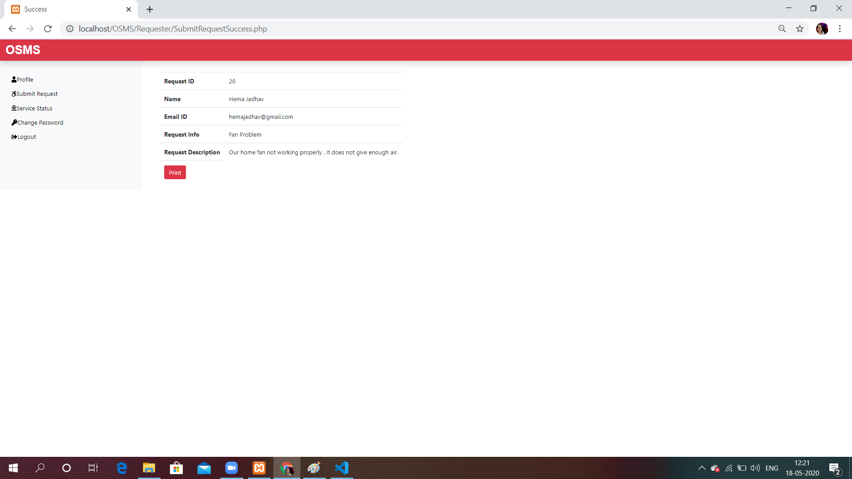
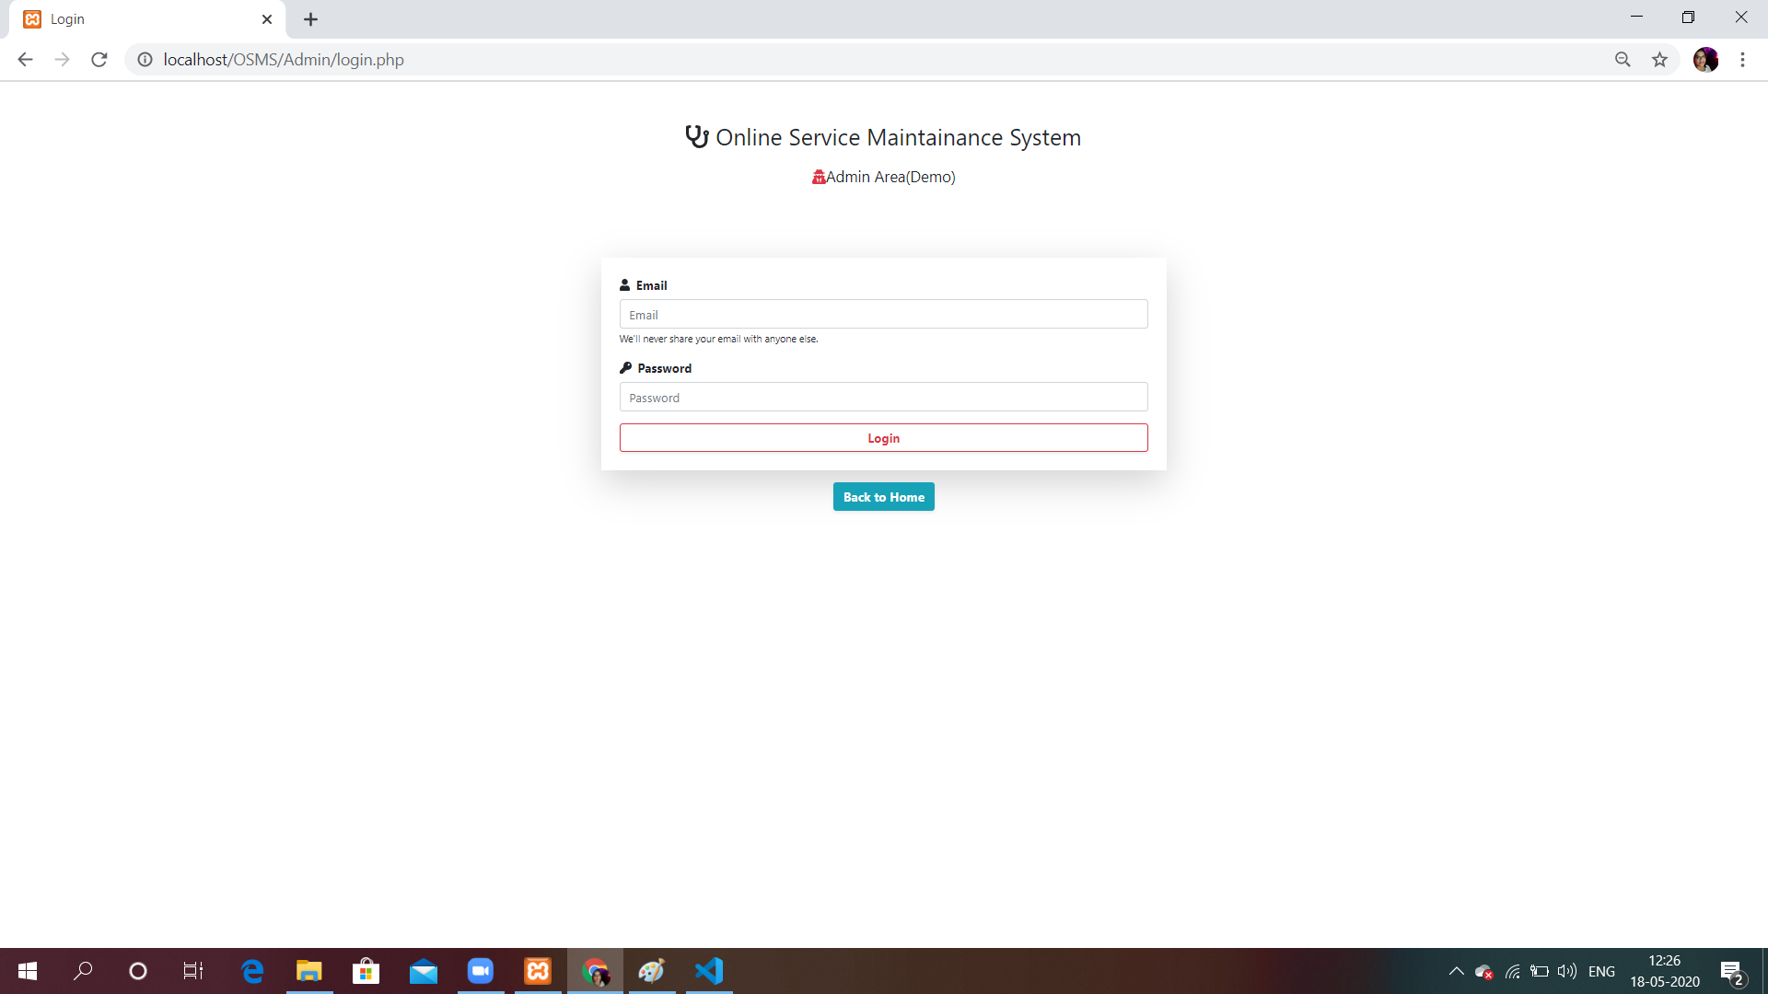
OUTPUT SNAPSHOTS ( Cont. )
User can print copy of submitted request
Admin Login Window

Slide 12
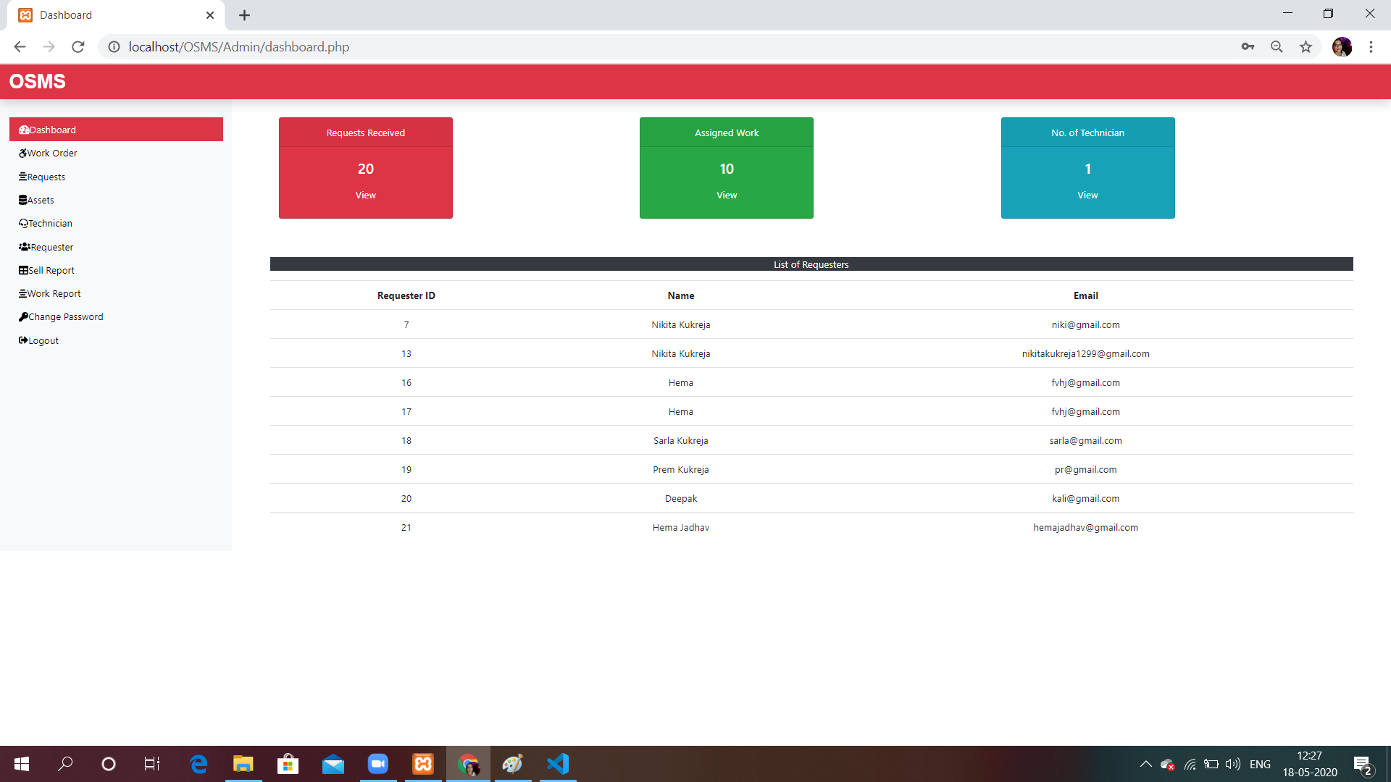
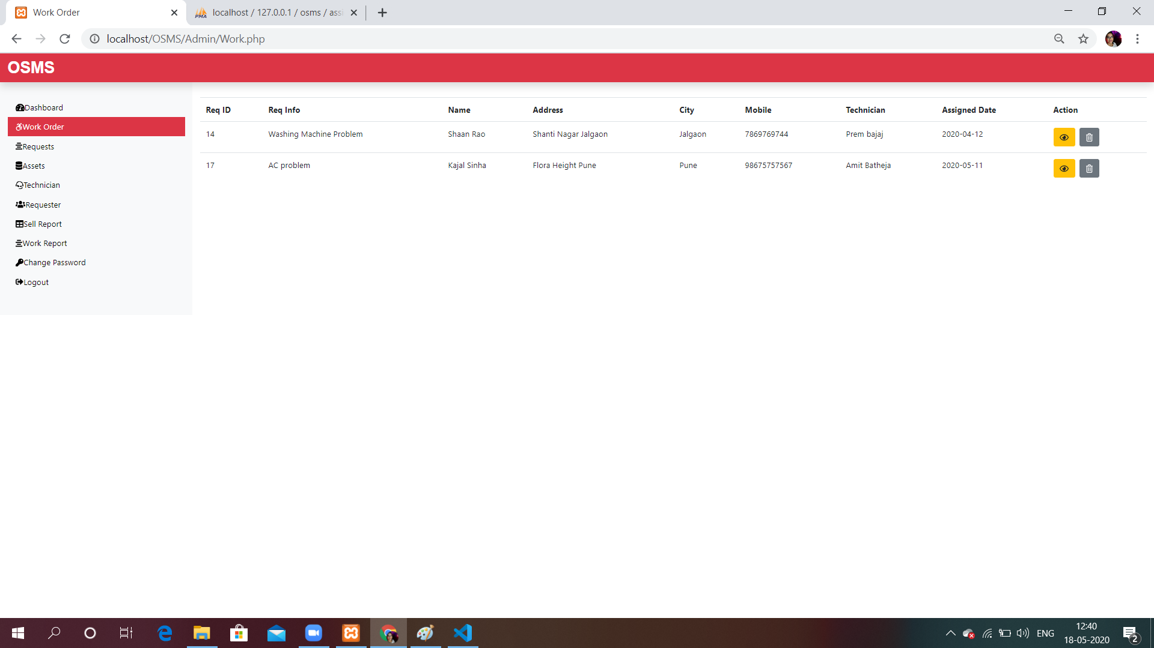
OUTPUT SNAPSHOTS ( Cont. )
Admin’s Dashboard
Work Orders

Slide 13
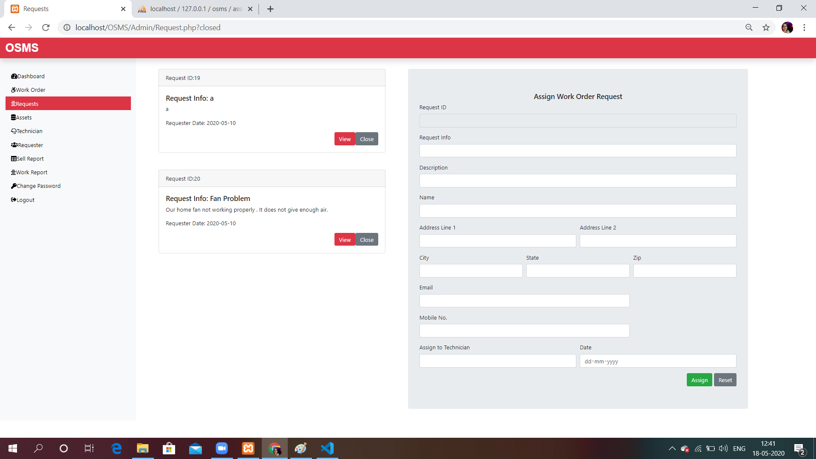
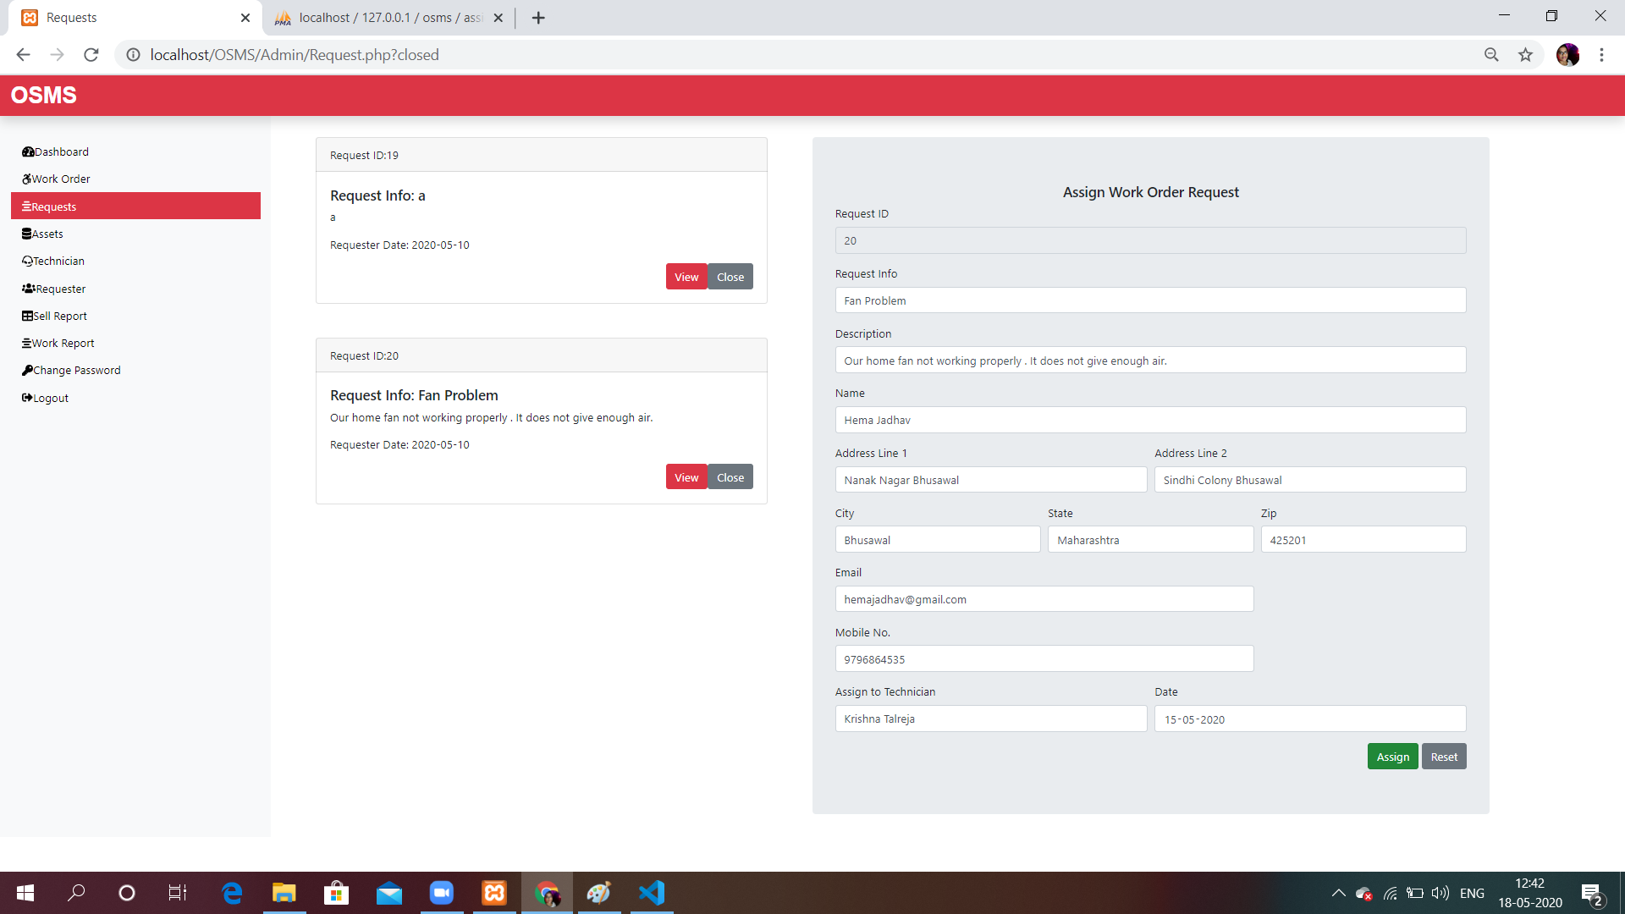
Output Snapshots ( Cont. )
Users Requests
Admin assign technician for user request

Slide 14
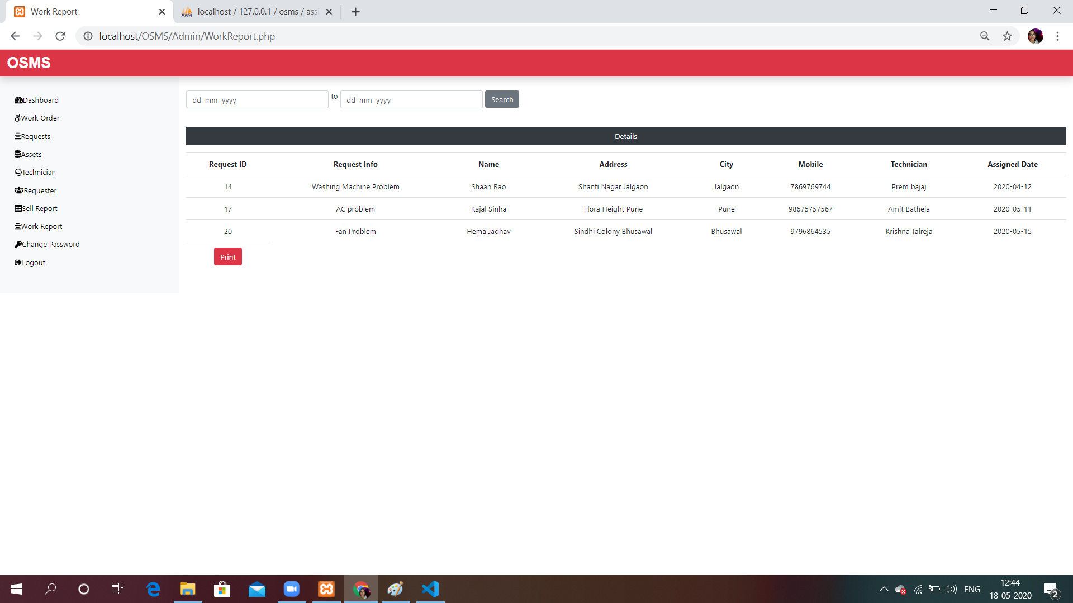
OUTPUT SNAPSHOTS ( Cont. )
Admin can view work report between different dates

Slide 15
CONCLUSION
Implementation of Online Service Management System helps to search for Assign work, Add/Remove Technician, Add/Remove Products etc.
It also has a facility of admin login through which the admin can monitor the whole system.
The admin can generate various reports such as Product Sell Report and Service/Work Report.

Slide 16
REFERENCES
The Complete Reference PHP
www.tutorialspoint.com
www.stackoverflow.com
Geeks for Geeks
W3school tutorial

Slide 17
Thank You !

